Slide 1

Florida Red Tide Mitigation and Technology Development Initiative
Kevin Claridge
Associate Vice President
Sponsored Research and Coastal Policy Programs
February 7, 2020

Slide 2
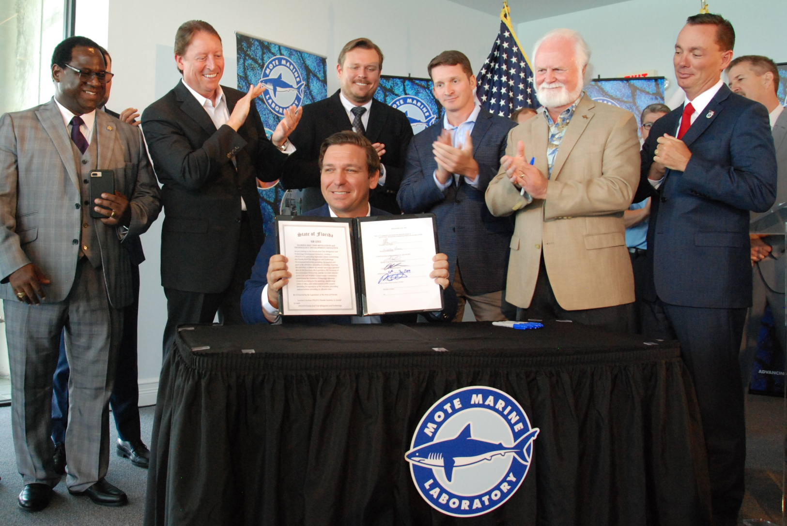
Florida Red Tide Mitigation and Technology Development Initiative
Governor DeSantis Signing in June 2019 at Mote

Slide 3
Red Tide Initiative Overview
Signed into law by Florida Governor DeSantis in June 2019
  379.2273 Florida Statutes
  Mote partnership with Florida Fish and Wildlife Conservation Commission, Fish and Wildlife Research Institute
$18 million over 6 years ($3 million per year) contracted by FWC-FWRI to Mote
Legislative intent:
  develop prevention, control, and mitigation technologies and approaches to address the impacts of red tide on coastal environments and communities in Florida
Year one has three parts:
  Infrastructure at Mote – lab space, culture lab, and mesocosms for:
  Mote led projects
  Partner led projects

Slide 4

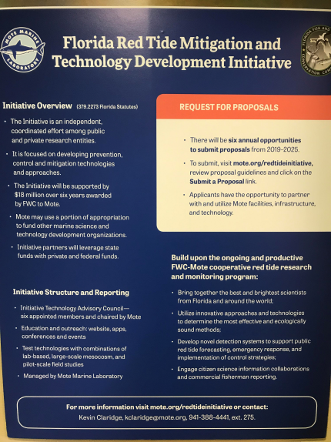
Red Tide Initiative Progress
Established Initiative Administrator and Administrative Support
Executed state contract between FWC and Mote
Outreach: press releases, speaking events, conferences, meetings, forums, partner newsletters, webinar, DEP Protecting Florida Together website, 2020 Oceans Day, and the Mote Red Tide Initiative website:
  https://mote.org/research/program/Florida-Red-Tide-Mitigation-and-Technology-Development-Initiative
    Partner institutions
    Initiative progress
    Initiative Technology Advisory Council
    Requests for proposals
    Reports
    Contact
    Quick links: Forecasts/current conditions
Statutory required Technical Advisory Council
  first meeting was Jan 17th
  Minutes on Mote Red Tide Initiative website

Slide 5
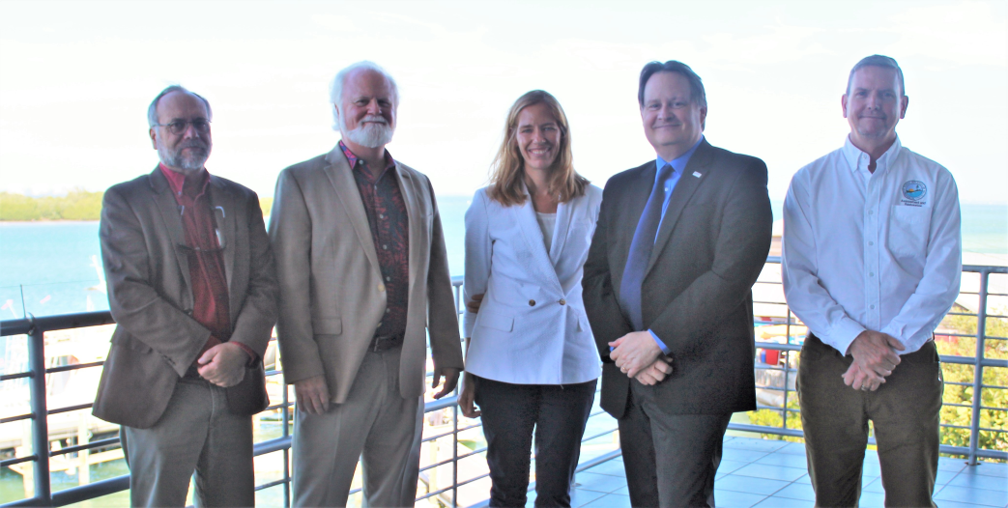
Technical Advisory Council
Dr. Michael P. Crosby – Mote President and CEO
Dr. James Powell – House Speaker Appt
Dr. James Sullivan – Senate President Appt
Dr. Katherine Hubbard – FWC Appt
David Whiting – DEP Appt
Governor Appt Pending

Slide 6
Initiative Reporting Requirements
Beginning January 15, 2021, and each January 15 thereafter until its expiration, the initiative shall submit a report that contains an overview of its accomplishments to date and priorities for subsequent years to the Governor, the President of the Senate, the Speaker of the House of Representatives, the Secretary of Environmental Protection, and the executive director of the Fish and Wildlife Conservation Commission.
Annual Workplans, Reports, and Invoices to FWRI
Website, Public Records, and Meeting Minutes

Slide 7
Mote Led Project Overviews
Facilities
  Mesocosm Facility
  Karenia brevis Culture Facility
Technology Development in Support of Mitigation
  Programmable Hyperspectral Seawater Scanner (PHySS)
  UAV (Unmanned Aerial Vehicle, Drone) based Detection System
  Beach Conditions Reporting Systems (BCRS)
  Quantitative Polymerase Chain Reaction (qPCR)
Mitigation Projects
  Compounds (Natural, Clay, Chemicals)
  Laboratory and Mesocosm

Slide 8
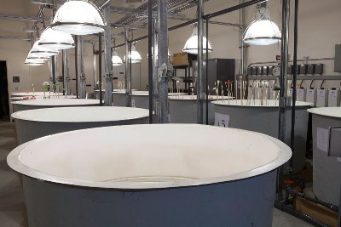
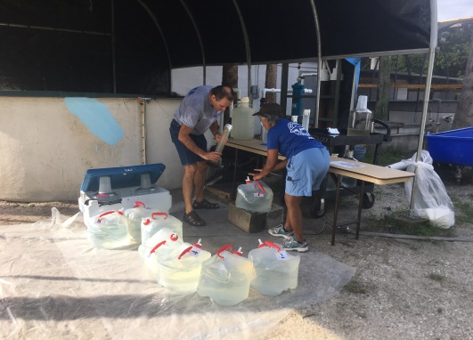
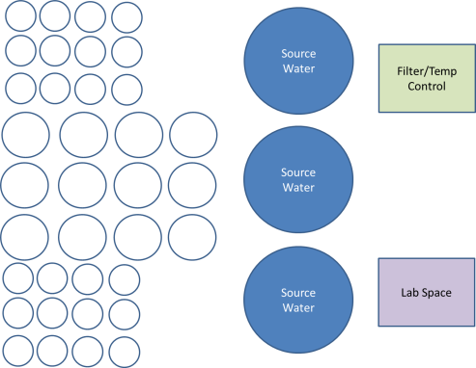
Experimental Mesocosm Facility
Motivation
To provide multi-scale, multi-user red tide research infrastructure for Initiative scientists
Goals
Used by visiting scientists, graduate students, educational groups, and in-house scientists
Ability to perform land-based mesocosm studies on red tide
Outcomes
Enable the development of innovative technologies and approaches that are critically needed to address control and mitigation of red tide impacts
Dedicated red tide mitigation mesocosm facility will allow more ecosystem-based testing of mitigation compounds in a controlled setting, reduce the need to postpone research or shorten experimental designs due to lack of available space and enable year-round, longer, multiple-use studies

Slide 9
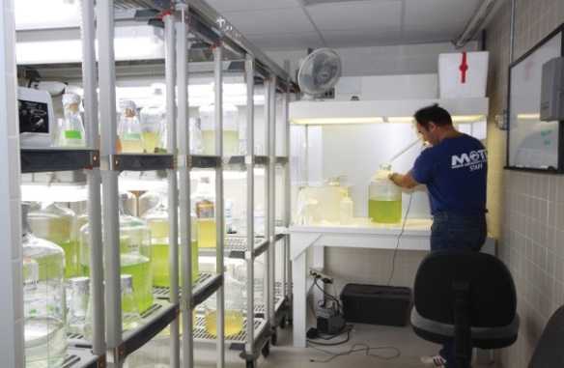
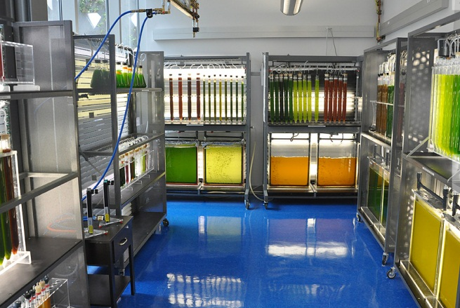
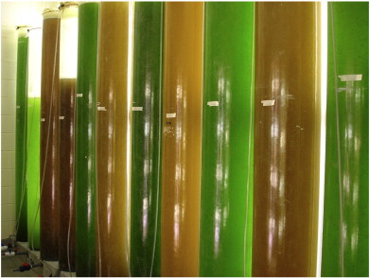
Phytoplankton Culture Facility
Motivation
To support the Initiative with Karenia brevis culture
Goals
Meet the demands of the mitigation research with consistent and reliable production of large volumes of K. brevis
Expand collection of K. brevis species (growing and maintaining several different strains)
Outcomes
Leverage Mote’s strong foundation of ecology, advanced biology and physiology to collaborate at state, national, and international levels and improve scientific productivity - i.e. support this Initiative with culture and Red Tide expertise

Slide 10
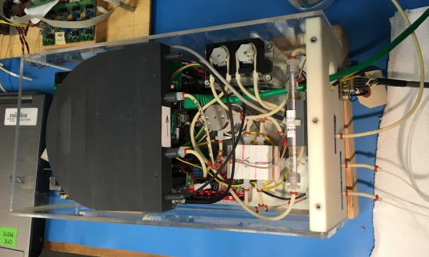
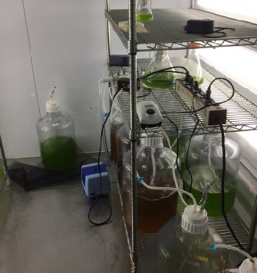
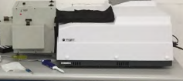
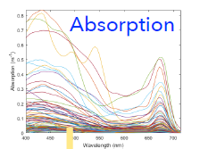
PHySS - Programmable Hyperspectral Seawater Scanner
Motivation:
Develop an instrument to aid in the mitigation of red tide and
provide early detection and warning
Developed at Mote; Similarity Index; fully programmable data acquisition with web-based data analysis tool
PHySS
Goals:
Stock Cultures
Develop a spectral library of different phytoplankton groups with variable morphologies and physiological states, optical signatures will be obtained for a range of cell densities
Improve sensitivity, identify multiple phytoplankton groups
Achieve concurrence with direct and remote observations of the SI estimates across different biological and physical regimes
Optical measurements
Outcome:
Form observatory providing continuous high frequency data
Data will be made publicly available in web based platform
Spectral signatures

Slide 11
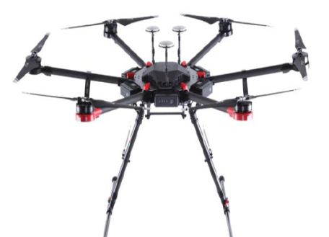
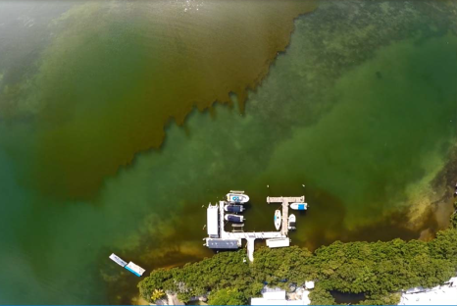
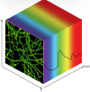
UAV-based Red Tide Detection System
Motivation:
Patchy nature of red tide makes mitigation technology challenging
Airborne hyperspectral sensors could allow the mapping of HABs with a high spatio-temporal resolution at local (drone) and regional (satellite) scales.
Goals:
Conduct shore-based flights in local waters
Collect hyperspectral data
Develop data processing scheme, instrument calibration and deliver proof-of-concept
Quality control check of algorithm performance
Implementation of new approaches for algorithm development
Imagery of red tide collected from drone
Hyperspectral
data cube
Outcomes:
Develop an application tool to assist in management of events that may involve significant risk to the public
Decrease costs of detection, improve mitigation application
Spatial dimension y
Spatial dimension x
Spectral dimension z (λ)

Slide 12

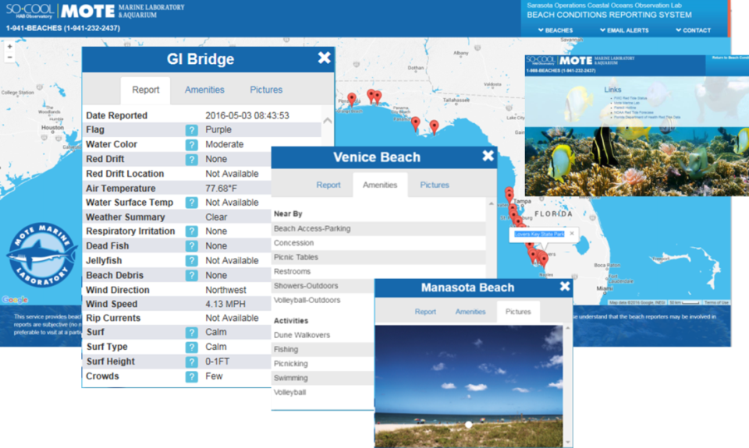
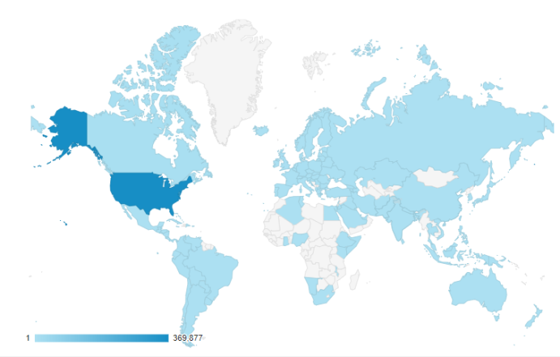
Advance Red Tide Reporting Technology
Motivation:
Alert the Public of Red Tide and its Effects and minimize economic impacts to Florida
Put red tide reporting technology in the hands of fisherman – coastal and offshore
Update/combine the Beach Condition Reporting System with the Citizen Science is Cool App
Enhance validation components (thumb up/down), pictures, amenities and alerts for blooms and reporting
    Bloom Zoom for cell detection, App for Chl-a
Goals:
Since October 15, 2017
Unique Users: 1.5Million
Page Views: >4.5Million
Outcomes:
Information disseminated to BCRS/App, GCOOS, SECOORA and NOAA
Reporting to/by anyone With a Cell Phone, anywhere.

Slide 13
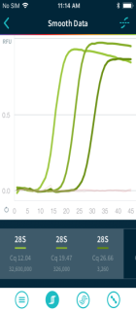
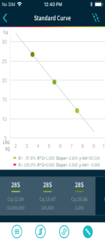
Acceleration of user-friendly, smart phone integrated qPCR technology development and Citizen Science integration for K. brevis mitigation testing
Motivation:
  Meet the ongoing, well-defined, need for new public-friendly, automated, web-interfaced detection methodologies that can provide accurate and timely cell monitoring data.
Biomeme
Three3
Overall Goal:
Accelerate the development and validation of a hand-held, qPCR based K. brevis and K. mikimotoi detector (Biomeme Three3) and develop protocols for integration into Citizen Science program.
Smart
Phone
9 samples per run
3 qPCR assays at once
Stable reagents
Smartphone interface
Cloud-based data storage
Outcomes:
Develop cell-based DNA standards from Gulf Karenia cultures,
Validate efficacy of existing K. brevis and K. mikimotoi primers
for use on the Biomeme Three9 simultaneously in a single reaction,
Provide training to Mote personnel on use of qPCR technology, and
Establish pipeline/protocols for linking and cross-calibrating cloud-
based qPCR data to existing Citizen Science databases.
Undergraduate use of Biomeme to monitor K. mikimotoi and Gloeotrichia in Maine

Slide 14
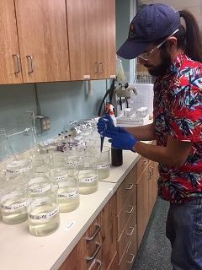
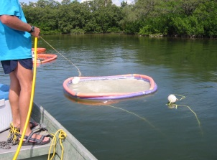
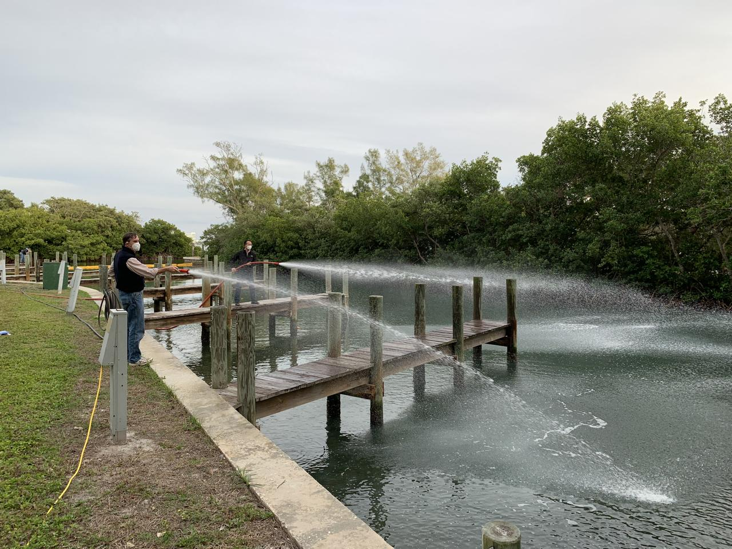
Mitigation Products & Processes
Introduction
Motivation:
To build on advancements made through the on-going FWC-Mote Cooperative Red Tide Research Program to develop science–based response strategies to reduce the intensity of red tide events and mitigate impacts on coastal ecosystems, Florida’s economy, and public health.
Overall Goal:
To develop, test and implement the most effective and ecologically sound products and technologies for mitigation and/or control of adverse impacts of Florida Red Tides, in collaboration with experts from multiple external research institutions.
Outcome:
Implement a tiered approach to investigate products in a science-based protocol to identify the most effective and ecologically sound products and technologies for mitigation and/or control of adverse impacts of Florida Red Tides.
● Tier 1. Lab-scale tests to determine the effective methodology for eliminating
K. brevis cells and toxins.
● Tier 2. Mesocosm-scale (larger volume, multiple organisms) to assess impacts of non-targeted marine organisms and water quality
● Tier 3. Open Field applications: Test the most appropriate method(s) under natural field conditions (timing depends on outcome of previous tests, permission for field application and red tide events).
Tier-1 Lab studies
Tier-2 Mesocosm- scale
Tier-3
Clay field application in canal

Slide 15
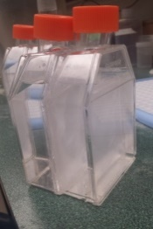
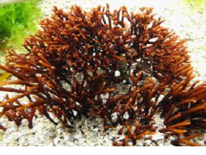
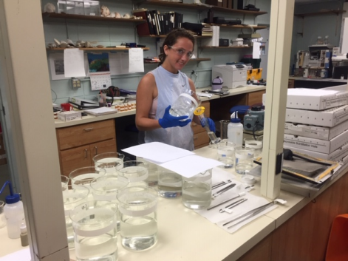
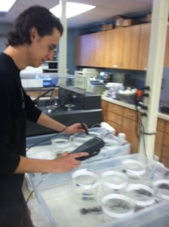
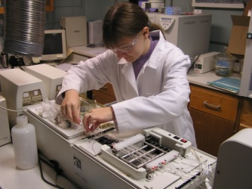
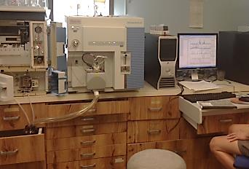
Mitigation Products & Processes
Applications
Potential Mitigation Products:
Natural Products
  Macro Algal Allelopathy; Barley straw extract
  Bacteria, Parasites, Viruses
Chemical Products
  Commercial algicides; Enzymes; Ozone; Bleach
  Surfactants-emulsifiers; Hydrogen peroxide
Physical Processes
  Clay; Nano-bubbles; UV-C radiation
Parameters Monitored:
Water Quality: DO, Temp, pH, PSU, CDOM, Nutrients
Red Tide cells and Tide Toxins
Phytoplankton Community Composition
Impacts/Toxicity to Marine Biota
  Mortality; Growth; reproduction
  Cellular function
extract
Gracilaria
K. brevis
Chemical products
Water Quality Nutrients Toxins

Slide 16
Initiative Engagement
Mote will facilitate funding engagement (as stated in Initiative statute):
  Leverage state funds with private and federal funds
  Mote may use a portion of appropriation to fund other marine science and technology development organizations in Florida and around the world to pursue applied research and technology

Slide 17
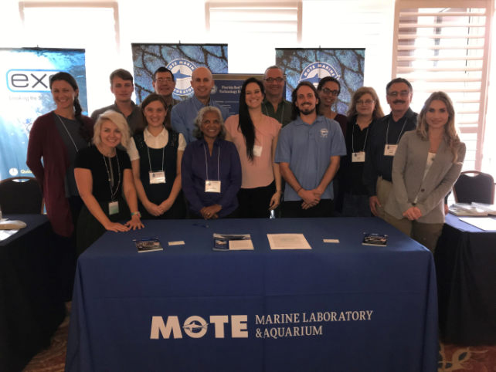
Request For Partner Proposals
Open to any/all interested parties
Anticipated grant funding in year one is $1M
  Likely $150-$250K for each grant, 4-5 organizations
  Support not to exceed 1 year –
    may request longer in second year RFP
Proposal guidelines and to submit a proposal:
  Mote.org
  Announced November 7th at US HAB Symposium
  Closed January 31st
  Notification of Awards in March
    Core infrastructure developed at Mote for projects
    Use of Mote facilities/infrastructure is encouraged
    Panel of scientists review
      NOAA, EPA, FWC, DEP, and University scientists
      Each scientist will review 3-5 proposals using provided questionnaire
      Projects will be selected by Mote and presented to TAC in April

Slide 18
Future Initiative Information
  Visit: https://mote.org/research/program/Florida-Red-Tide-Mitigation-and-Technology-Development-Initiative
Send: Kevin Claridge (kclaridge@mote.org) your email to be put on the distribution list for future webinars or other information

Slide 19
Questions?

